Slide 1
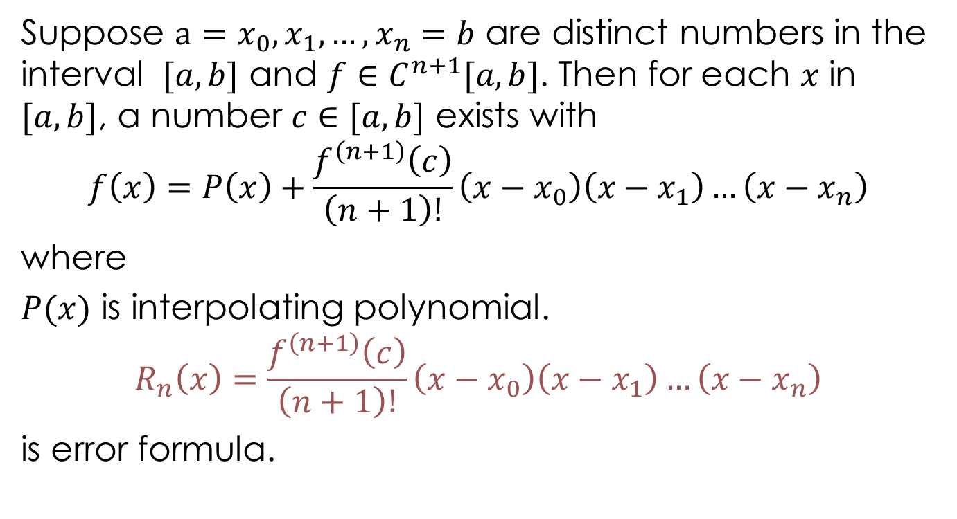
Error of Lagrange Interpolation Formula
Suppose $a=x_{0},x_{1}, …,x_{n}=b$ are distinct numbers in the interval $[a,b]$ and $f∈C^{n+1}[a,b]$. Then for each $x$ in $[a,b]$, a number $c∈[a,b]$ exists with
$$f\left(x\right)=P\left(x\right)+\frac{f^{\left(n+1\right)}\left(c\right)}{\left(n+1\right)!}\left(x−x_{0}\right)\left(x−x_{1}\right)…\left(x−x_{n}\right)$$
where
$P(x)$ is interpolating polynomial.
$$R_{n}\left(x\right)=\frac{f^{\left(n+1\right)}\left(c\right)}{\left(n+1\right)!}\left(x−x_{0}\right)\left(x−x_{1}\right)…\left(x−x_{n}\right)$$
is error formula.

Slide 2

Example 1:
Calculate error bound when Lagrange interpolation plynomial, obtained by using nodes $x=2,2.75 and 4$, is used to approximate $f\left(x\right)=\frac{1}{x}$ over the interval $[2,4]$.
Solution:

Slide 3
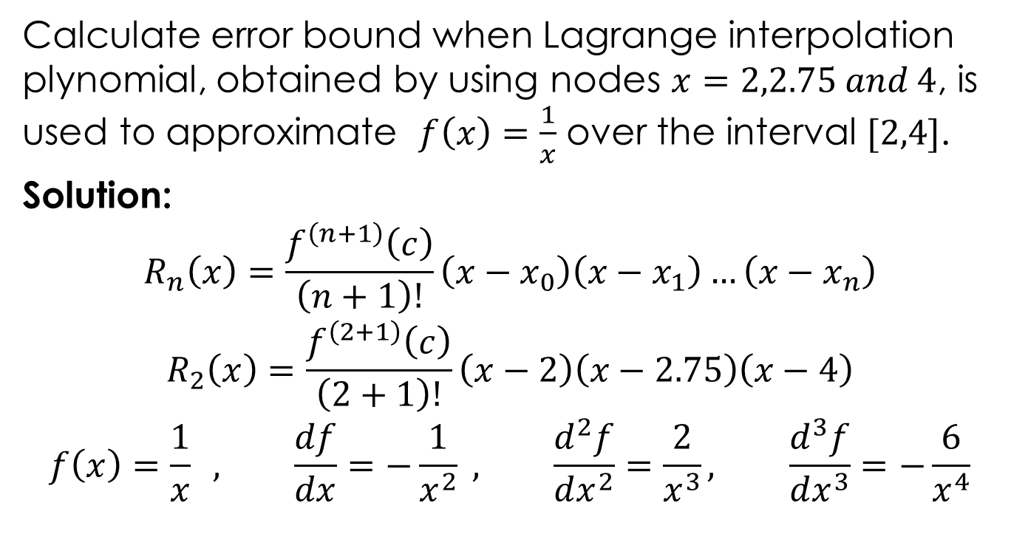
Example 1:
Calculate error bound when Lagrange interpolation plynomial, obtained by using nodes $x=2,2.75 and 4$, is used to approximate $f\left(x\right)=\frac{1}{x}$ over the interval $[2,4]$.
Solution:
$$R_{n}\left(x\right)=\frac{f^{\left(n+1\right)}\left(c\right)}{\left(n+1\right)!}\left(x−x_{0}\right)\left(x−x_{1}\right)…\left(x−x_{n}\right)$$
$$R_{2}\left(x\right)=\frac{f^{\left(2+1\right)}\left(c\right)}{\left(2+1\right)!}\left(x−2\right)\left(x−2.75\right)\left(x−4\right)$$
$$f\left(x\right)=\frac{1}{x} , \frac{df}{dx}=−\frac{1}{x^{2}} , \frac{d^{2}f}{dx^{2}}=\frac{2}{x^{3}}, \frac{d^{3}f}{dx^{3}}=−\frac{6}{x^{4}}$$

Slide 4
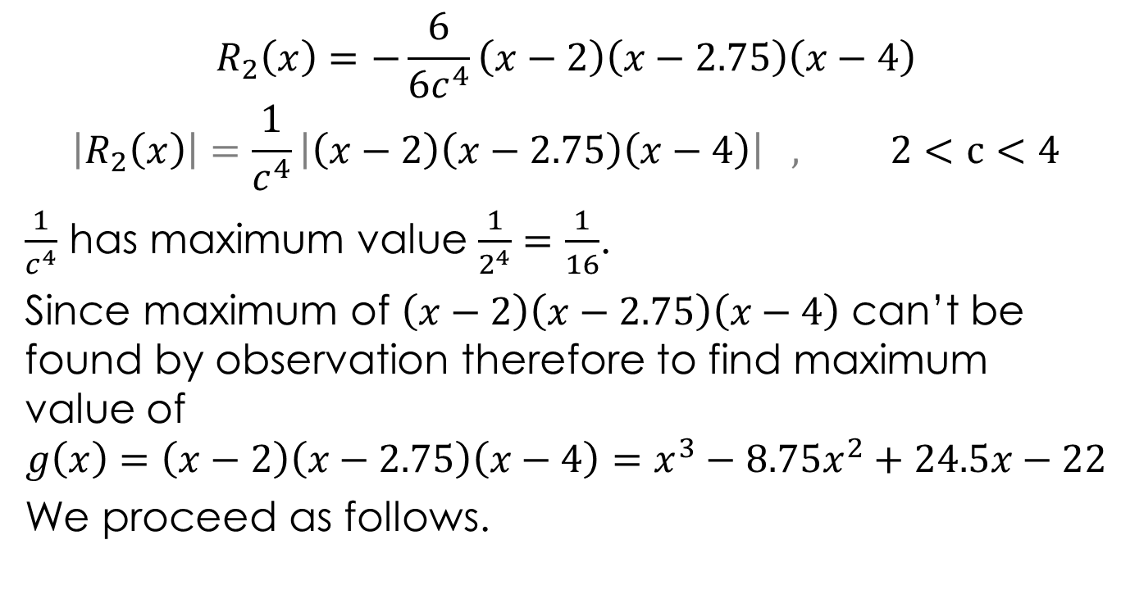
$$R_{2}\left(x\right)=−\frac{6}{6c^{4}}\left(x−2\right)\left(x−2.75\right)\left(x−4\right)$$
$$\left|R_{2}\left(x\right)\right|=\frac{1}{c^{4}}\left|\left(x−2\right)\left(x−2.75\right)\left(x−4\right)\right| , 2<c<4$$
$\frac{1}{c^{4}}$ has maximum value $\frac{1}{2^{4}}=\frac{1}{16}$.
Since maximum of $\left(x−2\right)\left(x−2.75\right)\left(x−4\right)$ can’t be found by observation therefore to find maximum value of
$$g\left(x\right)=\left(x−2\right)\left(x−2.75\right)\left(x−4\right)=x^{3}−8.75x^{2}+24.5x−22$$
We proceed as follows.

Slide 5

$$g^{′}\left(x\right)=3x^{2}−17.5x+24.5=0⇒x=\frac{7}{3} \& \frac{7}{2}$$
$$\left|g\left(\frac{7}{3}\right)\right|=0.2314 , \left|g\left(\frac{7}{2}\right)\right|=0.5625(max value)$$
$$\left|R_{2}\left(x\right)\right|≤\frac{1}{16}0.5625=0.0351$$

Slide 6

Home Exercise
Calculate error bound of Lagrange Interpolation polynomial for $f\left(x\right)=xlnx$ over the interval $[1,2]$ for the cases
$n=1$
$n=2$

Slide 7
Exercises
Numerical Analysis by Burden
Exercise 3.1: Solve questions related to Lagrange Interpolation Polynomial error.
Numerical Methods by Chapra
Exercise 18: Solve questions related to Lagrange Interpolation Polynomial error.

